Slide 1

Scrape data from google maps using python
By
Team 8
32,33,34,35

Slide 2
Agenda
1
2
3
4
5
Introduction
objective
Technologies used
Code overview
output

Slide 3
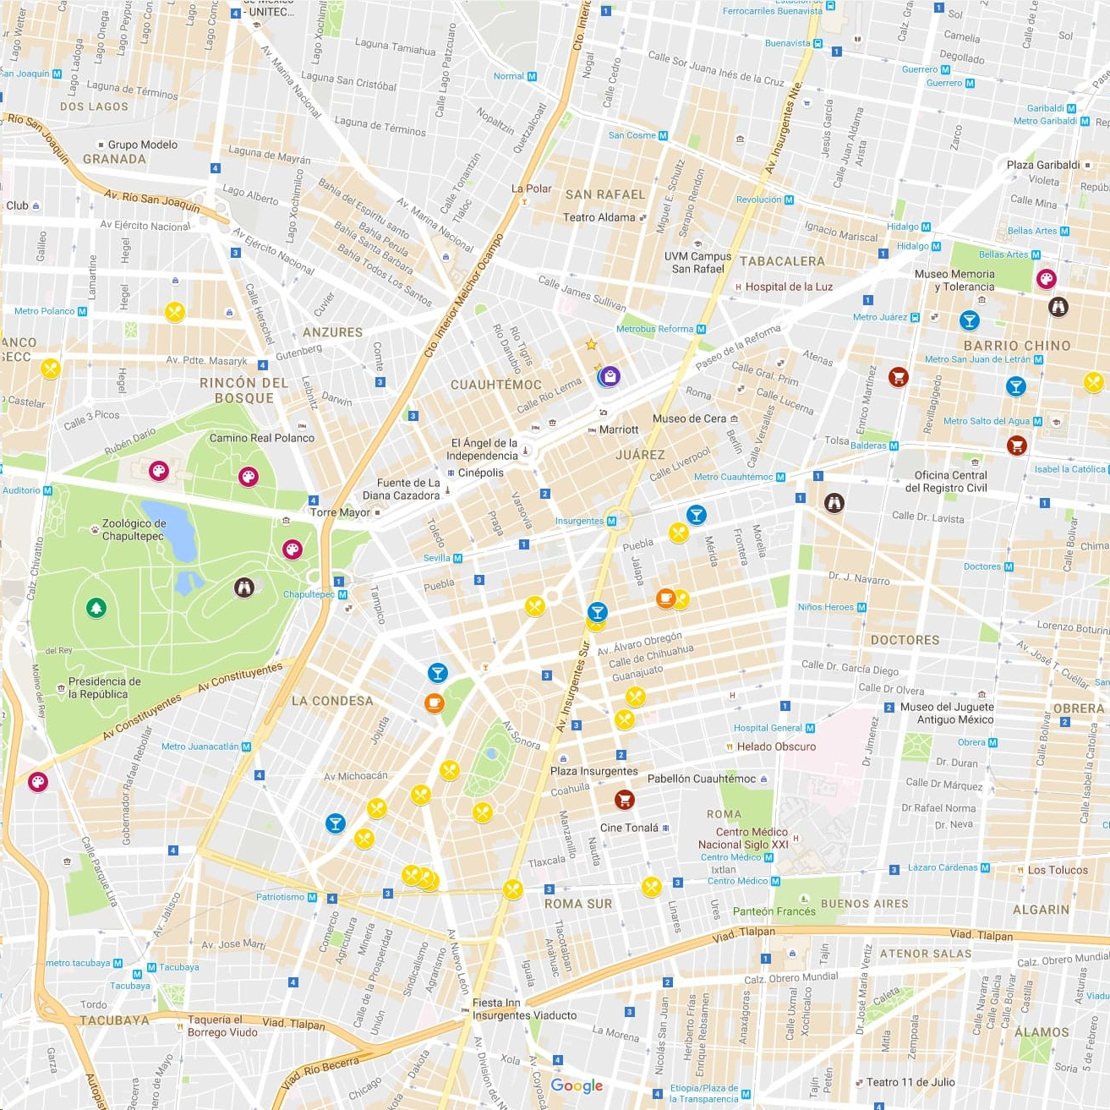
Introduction
Purpose of the project :-
Collecting data from google maps by using python
It helps in gathering various information like business details ,locations ,reviews and more. This data can be used for analysis, research, creating applications, or generating insights for business strategies, local services, or mapping purposes.

Slide 4
Technologies used:- programming language :- python

Slide 5
output:-
# Import the library Selenium
from selenium import webdriver
from selenium.webdriver.common.action_chains import ActionChains
Make browser open in background
options = webdriver.ChromeOptions()
options.add_argument('headless’)
# Create the webdriver object
browser = webdriver.Chrome(
executable_path="C:
\chromedriver_win32\chromedriver.exe",
options=options)
# Obtain the Google Map URL
url = ["https://www.google.com/maps/place/\
Papa+John's+Pizza/
@40.7936551,74.0124687,17z/data=!3m1!4b1!\
4m5!3m4!
1s0x89c2580eaa74451b:0x15d743e4f841e5ed!8m2!3d40.\
7936551!4d-74.0124687", "https://www.google.com/maps/place/\
Lucky+Dhaba/@30.653792,76.8165233,17z/data=!3m1!4b1!4m5!3m4!\
1s0x390feb3e3de1a031:0x862036ab85567f75!8m2!3d30.653792!4d76.818712"]
# Initialize variables and declare it 0
i = 0

Slide 6
# Create a loop for obtaining data from URL
sfor i in range(len(url)):
# Open the Google Map URL
browser.get(url[i])
# Obtain the title of that place
title = browser.find_element_by_class_name(
"x3AX1-LfntMc-header-title-title")
print(i+1, "-", title.text)
# Obtain the address of that place
address =
browser.find_elements_by_class_name("CsEnBe")[0]
print("Address: ", address.text)
print("\n")

Slide 7
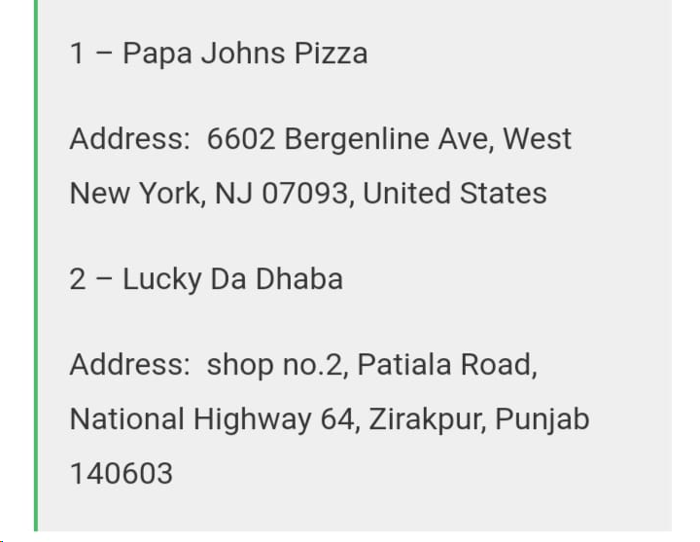
output

Slide 8
Thank you

